Slide 1
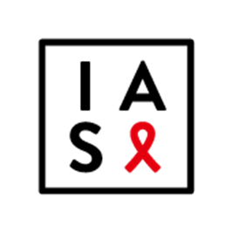
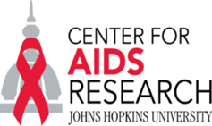
A Call to Action for Primary Prevention
Joep Lange Institute
July 22nd, 2018
Chris Beyrer MD, MPH
Desmond M. Tutu Professor
Associate Director, JHU CFAR
Johns Hopkins Bloomberg School of Public Health

Slide 2
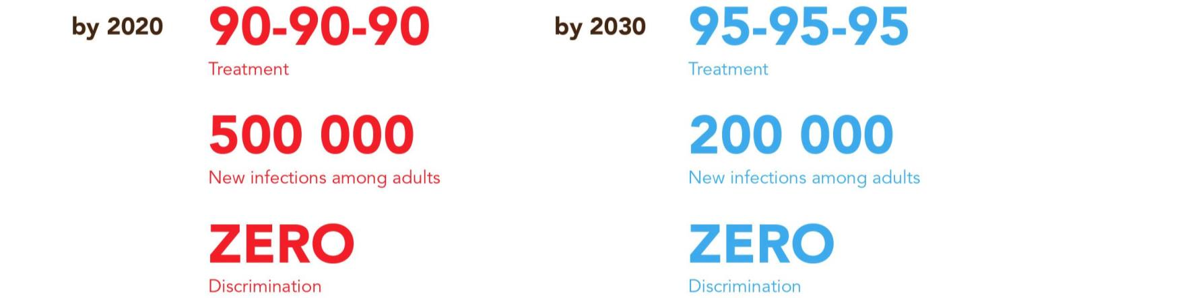

Targets for ending the AIDS epidemic

Slide 3
Where are we?
39 (28.9-41.5) million deaths since the pandemic began
2016: 1.0 (830 K-1.2) million HIV deaths
36.7 (30.8-42.9) million living with HIV
1.8 (1.6-2.1) million new infections (2016)
20.9 million on TX > Half of PLWHA
>40 Countries implementing PrEP
US, France, RSA, Kenya, Peru, Canada, Israel, Australia, EU
Adapted from UNAIDS Global Report 2017

Slide 4
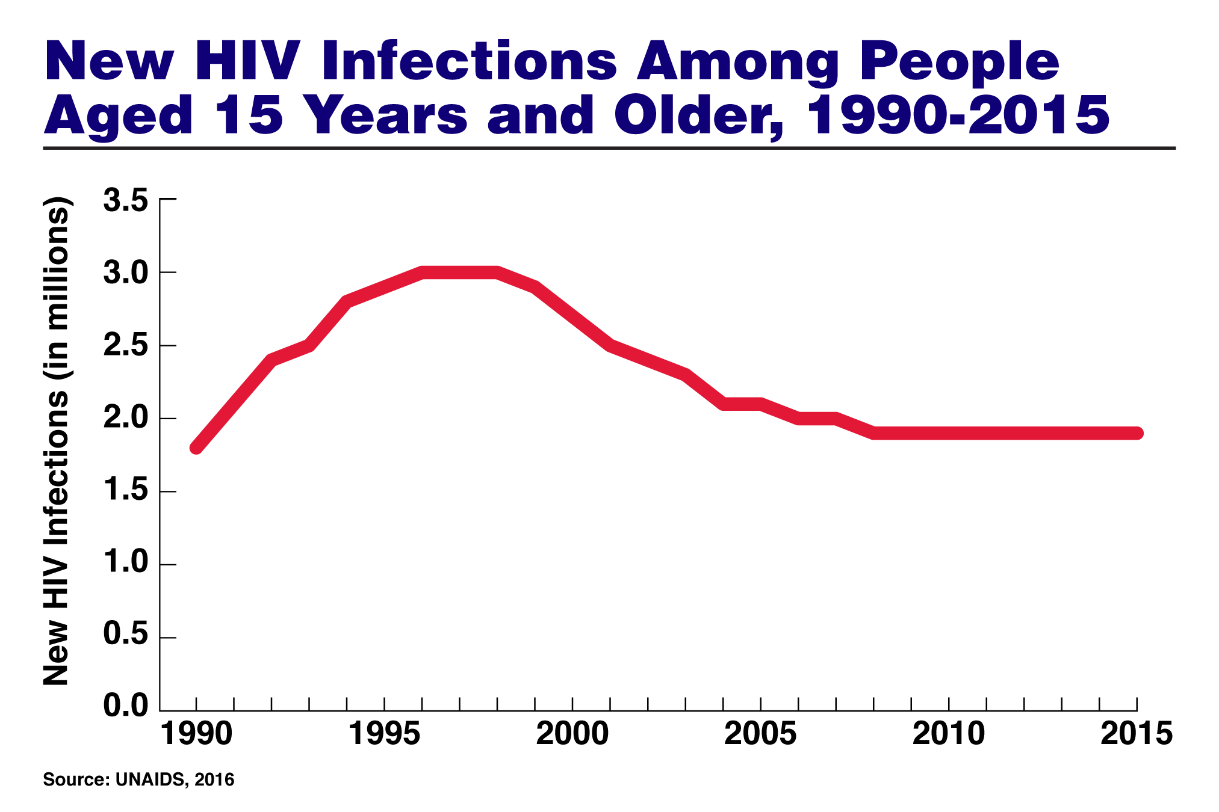

Slide 5
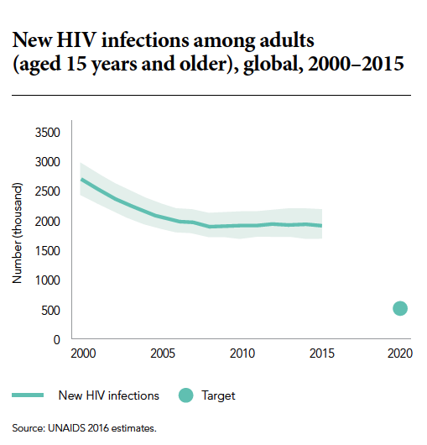
New infections in adults >15 yrs

Slide 6
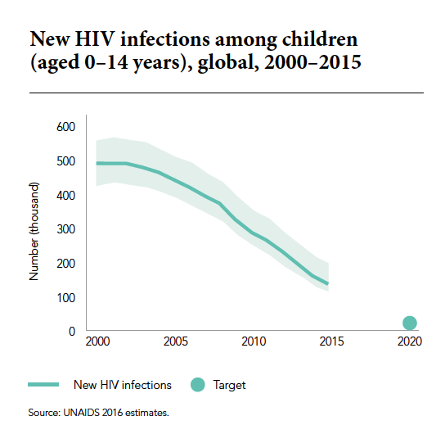
The promise of Prevention in ART

Slide 7
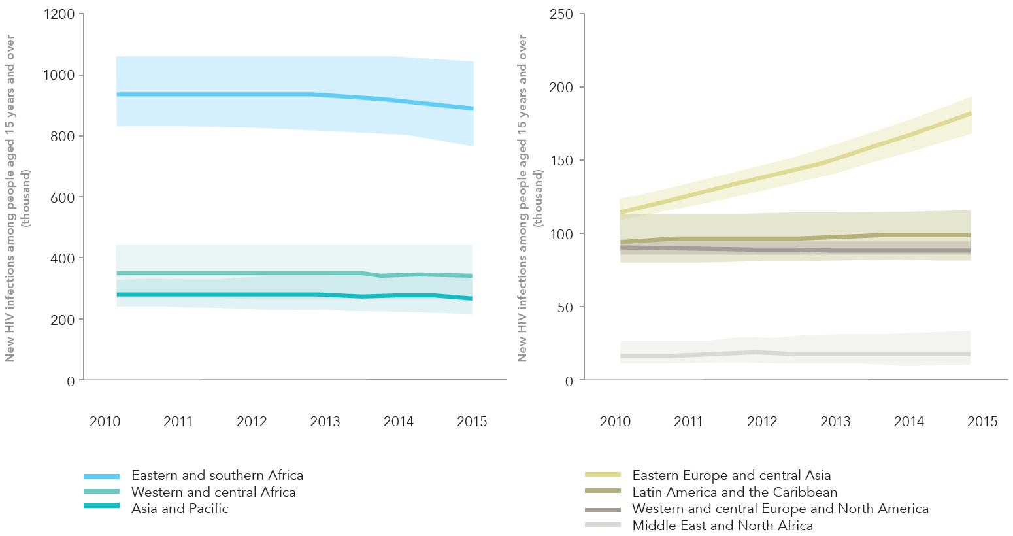
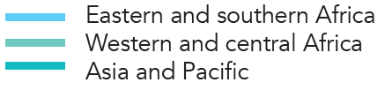
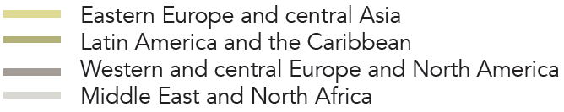
New HIV infections among people aged 15 years and over, 2010–2015
Source: UNAIDS 2016 estimates.

Slide 8
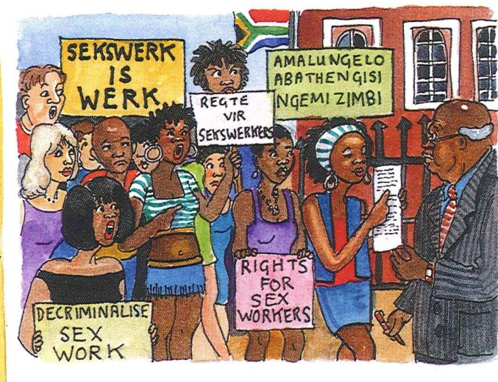
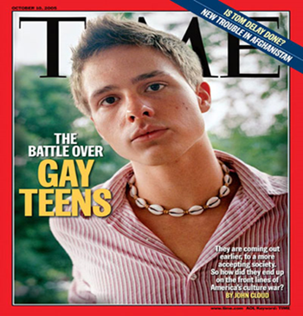
Key populations
Sex Workers, MSM, PWID

Slide 9
Key Populations and HIV
Key populations are those individuals and communities who have disproportionate burdens of HIV risk and disease and lack of access to essential HIV services
Gay, Bisexual, and other men who have sex with men (MSM)
Sex Workers of all genders
People who inject drugs (PWID) of all genders
Transgender Women who have sex with men
Prisoners and detainees
Women and Girls in South, East African hyper-epidemics
HIV uninfected partners in discordant relationships
Adolescents from all of these communities

Slide 10
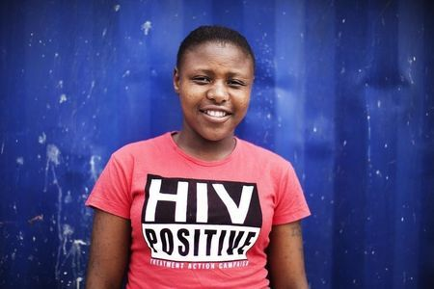
Eastern and Southern Africa: key populations are young women and adolescents
Young women Southern Africa
are 3-6x more likely HIV +
than males
Barriers: absence of adolescent-friendly services, low levels of access to health and education services, high age disparity in relationships
Notes:
Different population – adolescents and girls
Might want to expand on the barriers LGB, wasn’t sure about that

Slide 11
2.1 Million new infections in young populations globally
There are
26 new HIV infections
among adolescents (15-19) every hour.
Almost 40% of new HIV infections among adolescents occurred outside of sub-Saharan Africa.

Slide 12
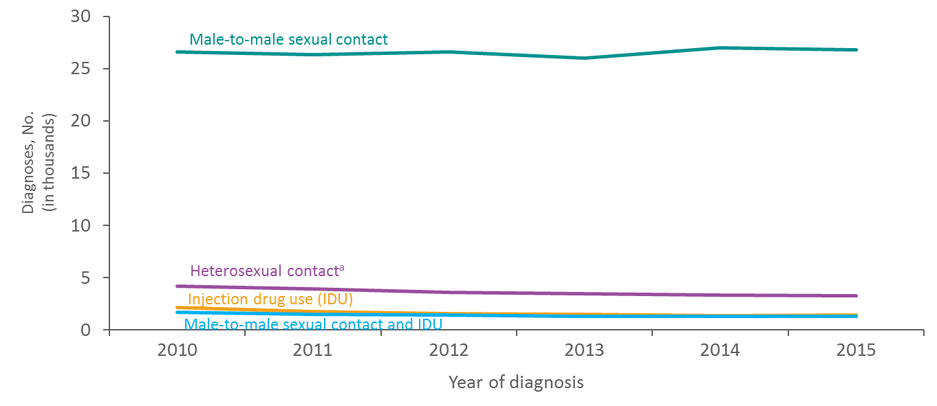
Diagnoses of HIV Infection among Male Adults and Adolescents, by Transmission Category, 2010–2015—United States and 6 Dependent Areas
Note. Data have been statistically adjusted to account for missing transmission category. “Other” transmission category not displayed as it comprises less than 1% of cases.
ª Heterosexual contact with a person known to have, or to be at high risk for, HIV infection.
Notes:
This slide presents the distribution of diagnoses of HIV infection among male adults and adolescents with infection diagnosed from 2010 through 2015, by transmission category, for the United states and 6 dependent areas.
The number of diagnoses of HIV infection among male adults and adolescents attributed to male-to-male sexual contact remained stable, 26,577 in 2010 to 26,753 in 2015. From 2010 through 2015, among male adults and adolescents, the number of diagnoses of HIV infection attributed to heterosexual contact decreased by 22% (from 4,175 in 2010 to 3,274 in 2015); diagnoses of infections attributed to injection drug use decreased by 34% (from 2,125 in 2010 to 1,403 in 2015); and diagnoses of HIV infections attributed to male-to-male sexual contact and injection drug use decreased by 22% (from 1,652 in 2010 to 1,288 in 2015). The “Other” transmission category is not displayed as it comprises 1% of all reported cases. The category includes hemophilia, blood transfusion, perinatal exposure, and risk factor not reported or not identified.
Data have been statistically adjusted to account for missing transmission category.
Heterosexual contact is with a person known to have, or to be at high risk for, HIV infection.

Slide 13
Eastern Europe and Central Asia 2016 data
In 2016, 1.6 million [1.4 million–1.7 million] people living with HIV
190 000 [160 000–220 000] new HIV infections
New HIV infections rose by 60% from 2010 and 2016
40 000 [32 000–49 000] people died of AIDS related illnesses in 2016
Treatment coverage 28% [22–32%] among people living with HIV
AIDS-related deaths increased by 27% from 2010 and 2016.
UNAIDS Fact Sheet-WAD, Dec. 1, 2017

Slide 14
The expanding epidemic of HIV-1 in the Russian Federation. PLoS Med; Dec. 1, 2017
HIV
2017 Russia had the largest number of HIV infected citizens in Europe
Cumulative HIV diagnoses over 1.16 million by mid-year 2017
Over 103,000 new HIV diagnoses in 2016: a 5% increase over 2015
Among Russian men aged 30-39 years of age, 2.8% living with HIV
AIDS
From Jan-June 2017, 14,631 deaths due to AIDS recorded: 13.5% increase over previous 6 months
AIDS now in top 10 leading causes of premature death

Slide 15
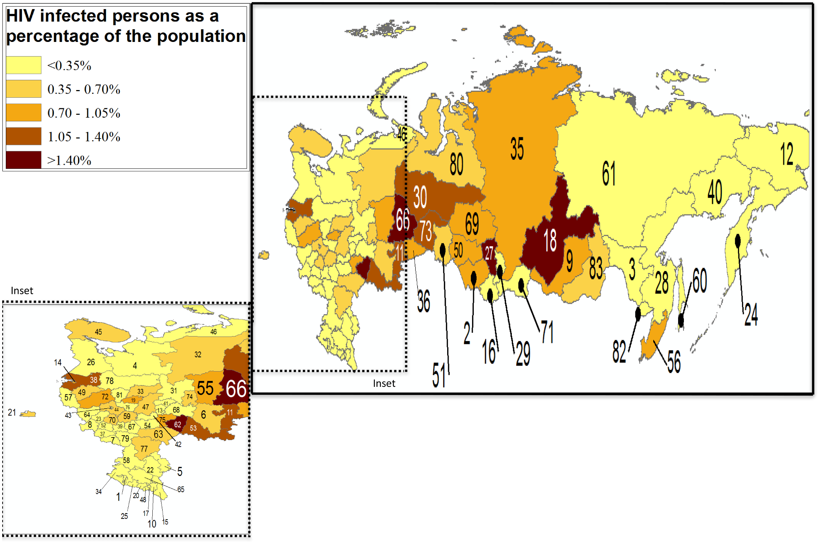
Cumulative HIV diagnoses in the Russian Federation, through 2016
Cumulative HIV diagnoses in the Russian Federation, 2016
Beyrer C, Wirtz AL, O’Hara G, Leon N, Kazatchkine M. PLoS Medicine. 2017

Slide 16
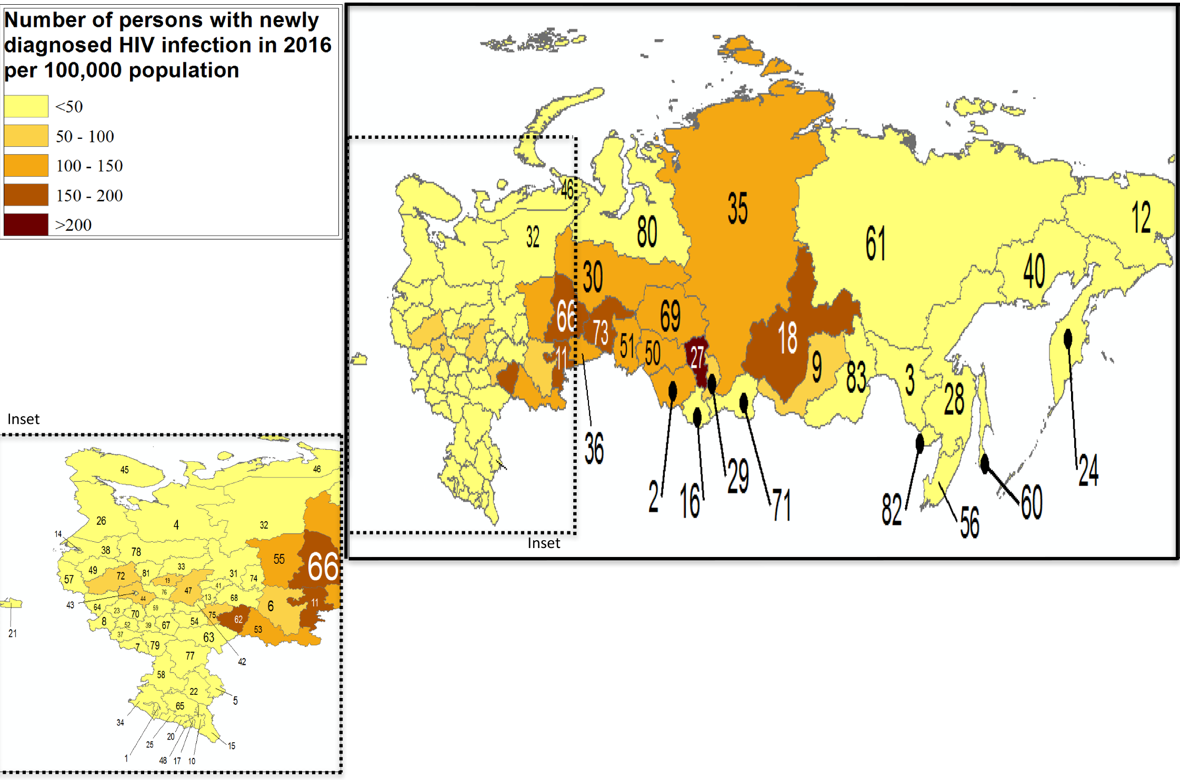
New HIV Diagnoses in the Russian Federation
Annual new HIV diagnoses reported in 2016 per 100,000 population
Beyrer C, Wirtz AL, O’Hara G, Leon N, Kazatchkine M. PLoS Medicine. 2017

Slide 17
HIV Care Continuum for MSM in Moscow
* Weighted with RDS-II estimator
Wirtz et al. Sex Trans Infect 2015
Notes:
Among those linked to care, 48.4% were on ART
Add bar to represent total sample living with HIV; add error bars for RDS estimates

Slide 18
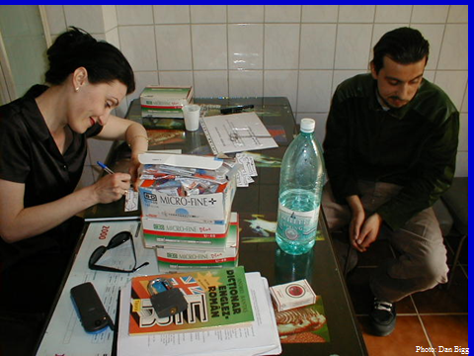
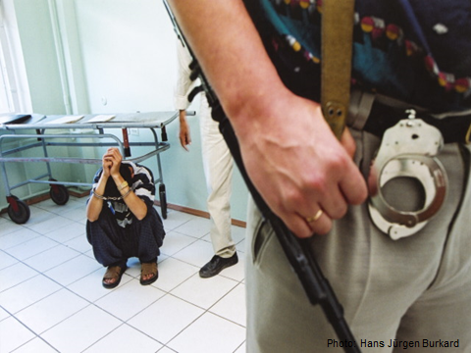
People who inject drugs

Slide 19
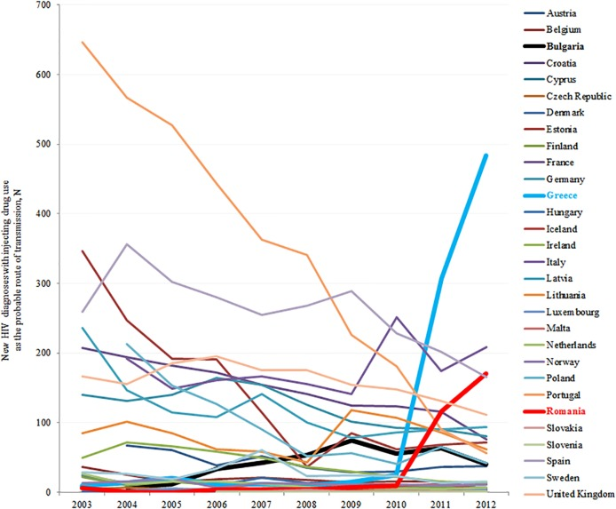
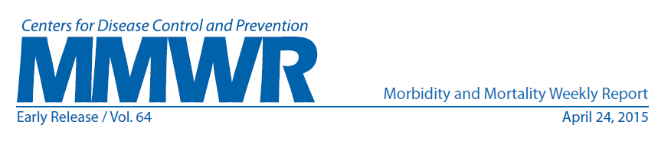
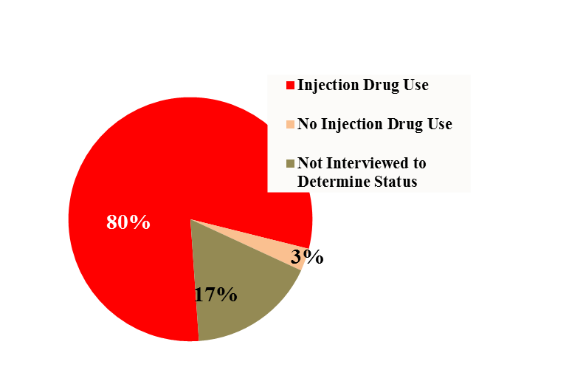
HIV can Disseminate very rapidly among PWID
Outbreak of HIV in Greece and Romania
Outbreak of HIV Linked to Oxymorphone in Indiana, USA, 2015
Average 9 syringe-sharing
partners, sex partners
In Scott County, which is a community of 4200 people there have been 173 new HIV Infections since January of 2015
In Greece there were: 2000-2010, 9-19 new HIV cases in IDU (2%–3% of all cases); in 2011, 266 cases in IDU ( 28% of HIV cases) and in 2012, 547 cases in IDU (46% of HIV cases)

Slide 20
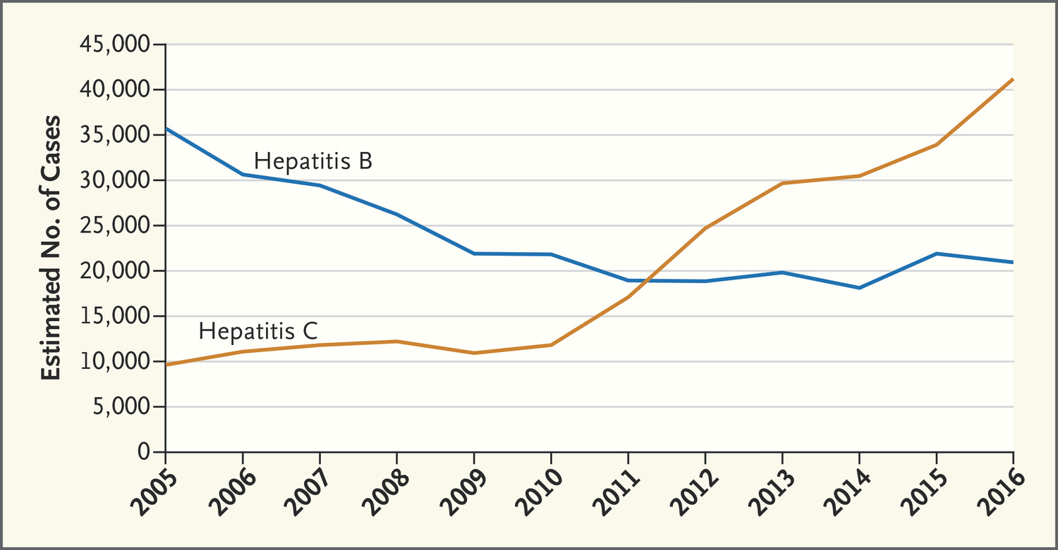

TJ Liang, JW Ward. N Engl J Med 2018;378:1169-1171.
Estimated Number of New Hepatitis B and Hepatitis C Infections in the United States, by Year.
Notes:
Estimated Number of New Hepatitis B and Hepatitis C Infections in the United States, by Year. Data are from the Centers for Disease Control and Prevention and are adjusted for the expected number of people with acute hepatitis B virus and HCV infections who become symptomatic, seek medical care, and are reported to state or local public health surveillance.

Slide 21

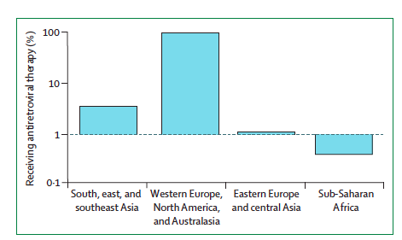
Figure 8: Proportion of injecting drug users living with
HIV who receive antiretroviral therapy, by region
Notes:
Data on the y-axis are on a log scale. No data are available for Latin America and
the Caribbean, or for the Middle East and north Africa. Adapted with permission
from UNAIDS, 2014.55

Slide 22
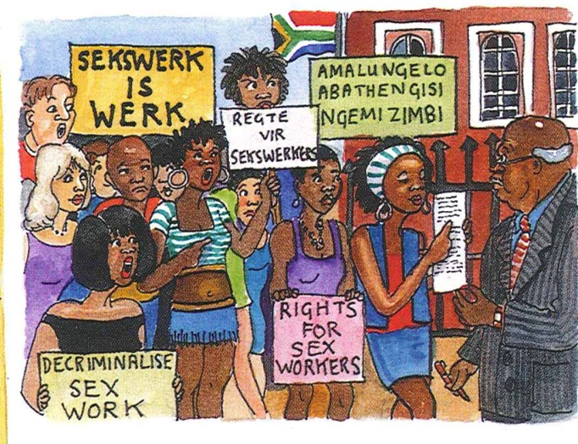
Calls to Action

Slide 23
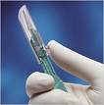
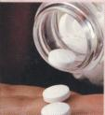

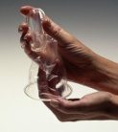
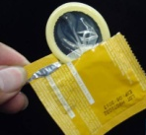
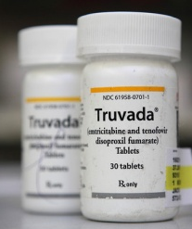
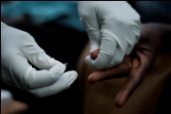
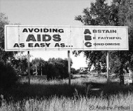

Tools for preventing sexual transmission of HIV
Male circumcision
Auvert B, PloS Med 2005
Gray R, Lancet 2007
Bailey R, Lancet 2007
Treatment of STIs
Grosskurth H, Lancet 2000
Treatment for prevention
Female Condoms
Cohen M, NEJM, 2011
Donnell D, Lancet 2010
Tanser, Science 2013
HIV
PREVENTION
Male Condoms
Oral pre-exposure prophylaxis
HIV Counselling and Testing
Grant R, NEJM 2010 (MSM)
Baeten J , NEJM 2012 (Couples)
Paxton L, NEJM 2012 (Heterosexuals)
Choopanya K, Lancet 2013 (IDU)
Coates T, Lancet 2000
Sweat M, Lancet 2011
Behavioural Intervention
Post Exposure
prophylaxis (PEP)
Scheckter M, 2002
Note: PMTCT, Screening transfusions, Harm reduction, Universal precautions, etc. have not been included
Notes:
Will update

Slide 24
Combination prevention with treatment is more effective, esp. when PrEP and ART are non-overlapping regimens.
Test & Treat strategies strengthen this even more so.
Abbas et al., 2013

Slide 25



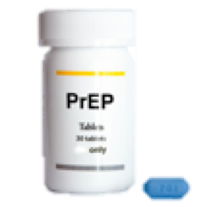
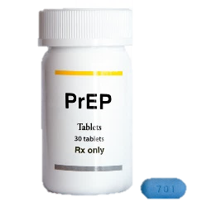
But we need to Be Risk Period Specific: NOT PrEP for Life
PrEP implemented at only high-risk periods reduces the need for treatment & prevention during later stages of life & is more cost effective:
X – no need for PrEP here
PrEP for 3-4 Years while young & at high risk
PrEP for 3-4 Years while young
High-Risk Period: 15-24 Years
22-28 Years

Slide 26
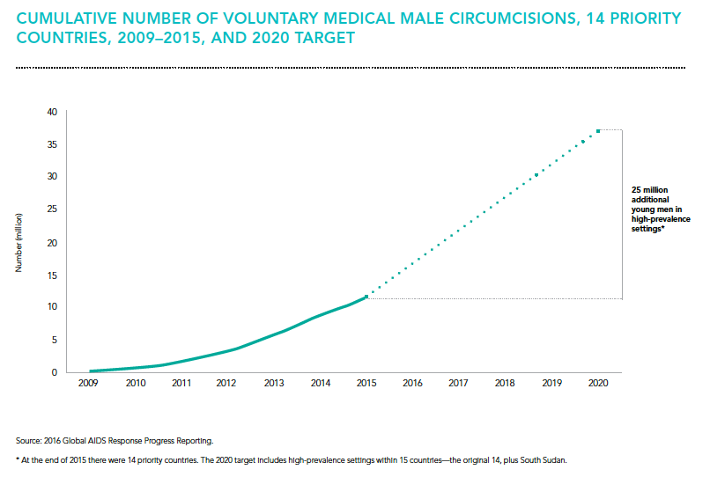
Medical Male Circumcision: 55-65% reduction of HIV acquisition in uninfected males
VMMC target in RSA : 4.2 Million

Slide 27
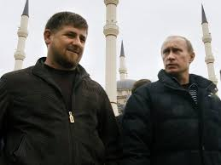
Rights Violations: Chechnya 2017
Russian police round up LGBT activists demonstrating against persecution of gay men in Chechnya. [Independent May 1, 2017]
More than 100 men have been rounded up and detained in secret prisons by authorities in recent weeks, with many beaten and tortured.
At least four are alleged to have been killed.
“If there were such people in Chechnya, the law-enforcement organs wouldn’t need to have anything to do with them because their relatives would send them somewhere from which there is no returning.”

Slide 28
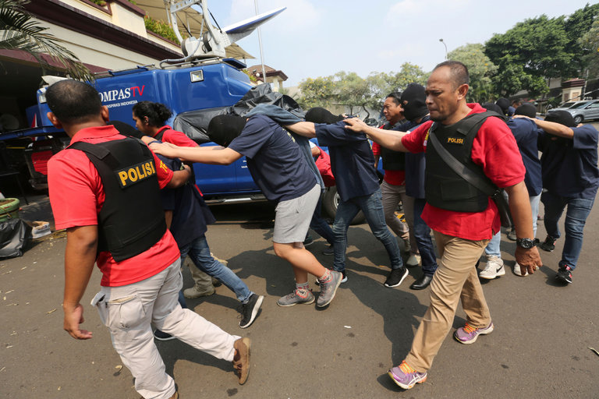
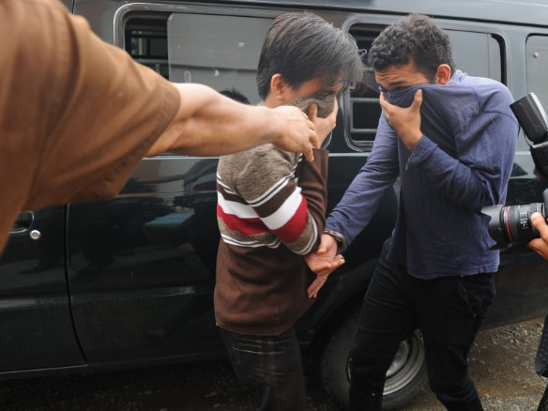
Sharia court sentences gay men to public lashing in Indonesia
--Yosef Riadi and Juliet Perry, CNN May 17, 2017
Indonesia Police Arrest 141 Men Accused of Having Gay Sex Party
JON EMONT, NYT, MAY 22, 2017
Increasing intolerance in many communities in the region.
Stigma and fear reduce gay/MSM access to essential HIV services and can measurably increase HIV viral loads at community level. (Schwartz, et al, IAS 2015).

Slide 29

AMERICA LAST
How the ‘Trump Effect’ Is Endangering LGBT People Worldwide International activists say the effects of the Trump administration’s actions (and inactions) are already being felt.
The Daily Beast
Jay Michaelson
05.19.17 1:00 AM ET
Human Rights Undermined
“It’s not just liberal democracy in danger,”
“It’s the rule of law internationally. It’s the international system itself. It’s the notion that human rights are universal and sacred. That’s what’s at stake with the Trump administration.” --Jessica Stern, OutRight Action Intl.
.

Slide 30
Return to Maximum Sentencing
May, 2017, Attorney General Jeff Sessions directed federal prosecutors to seek the maximum penalty possible in every case
“Instead of providing people who commit low-level drug offenses or who are struggling with mental illness with treatment, support and rehabilitation programs, the policy will subject them to decades of incarceration,” they wrote. “In essence, the Attorney General has reinvigorated the failed ‘war on drugs.’ ”
Townes, C. The War on Drugs Never Ended. Slate, Aug 1, 2017

Slide 31
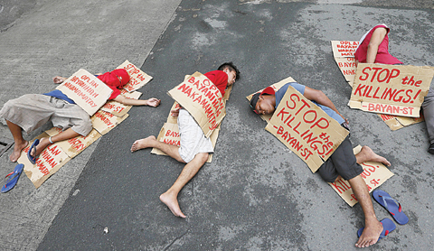
Philippines: Duterte’s War on Drugs
Human Rights Watch: “License to Kill” March, 2017
Since the inauguration of President Rodrigo Duterte on June 30, 2016, and his call for a “war on drugs,” Philippine National Police officers and unidentified “vigilantes” have killed over 7,000 people.
The anti-drug campaign dubbed “Operation Double Barrel”… in practice has been a campaign of extrajudicial execution in impoverished areas...
Duterte’s outspoken endorsement of the campaign implicates him and other senior officials in possible incitement to violence, instigation of murder, and in command responsibility for crimes against humanity
QUEZON CITY: Protesters stage a “die-in” to dramatize the rising number of extra judicial killings related to Philippine President Rodrigo Duterte’s “War on Drugs” yesterday in front of the Philippine National Police headquarters. —AFP (May 15, 2017)

Slide 32
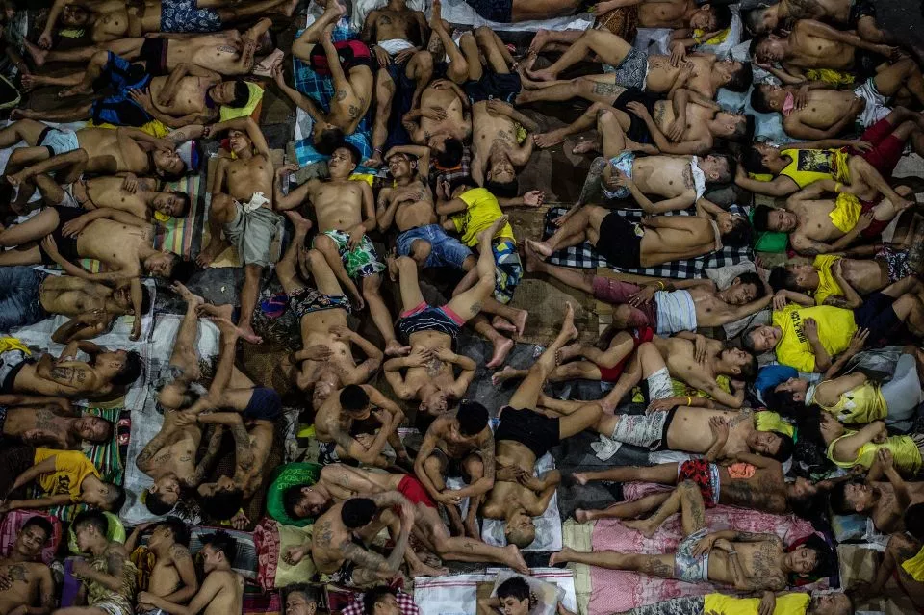
Duterte’s War and HIV
Duterte’s War on Drugs not only violates human rights, it is also likely to have significant negative public health consequences...harsh drug enforcement can lead to drug users going underground
away from critical health services.
This can fuel the transmission of HIV and Hepatitis C among people who used drugs and may discourage people with drug dependence from seeking effective treatment services.
Human Rights Watch: “License to Kill” March, 2017

Slide 33
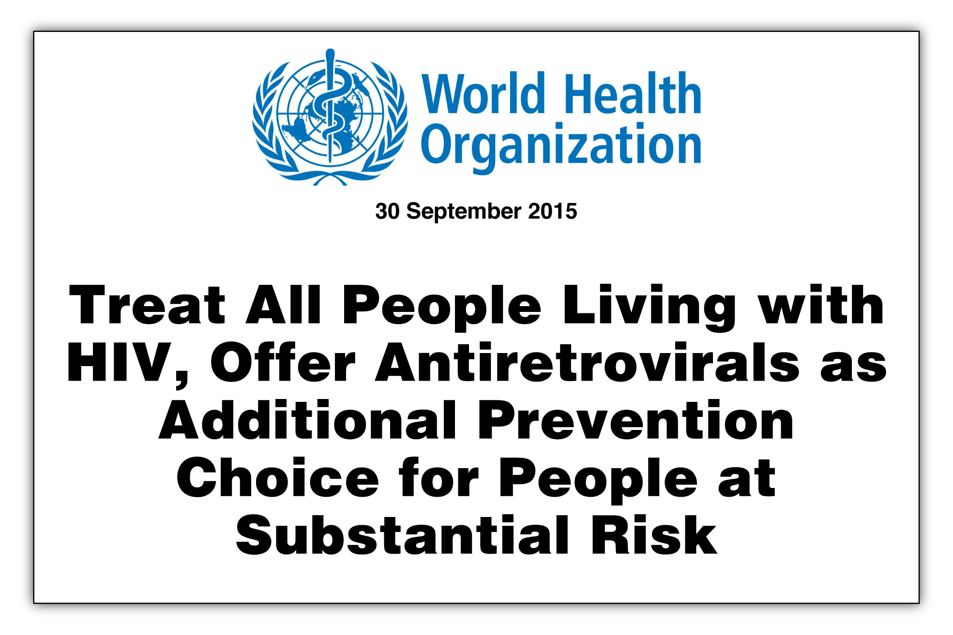

Slide 34
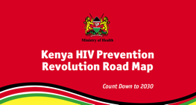
Kenya’s Roadmap to HIV Prevention:
Kenya HIV Prevention Revolution Roadmap: Counting down to 2030

Slide 35


Acknowledgements
Johns Hopkins
Stef Baral, Michele Decker, Brian Weir, Andrea Wirtz
Others
Linda-Gail Bekker, David Barr, Gottfried Hirnshchall, Michel Kazatchkine, Nolwen Leon, George O’Hara
Supported by grants to the Center for Public Health and Human Rights at John Hopkins from
  National Institutes of Health/NIMH
  The Global Fund
The John Hopkins Center for AIDS Research (NIAID, 1P30AI094189-01A1)

